Slide 1





Washington State Electric Vehicle Adoption Trend Analysis
Case Study on:
A Portfolio Project By Kaustav Mandal
Using tools like

Slide 2
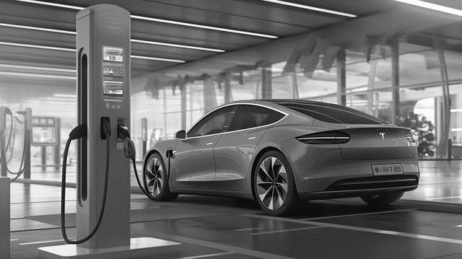

Contents
Introduction
Objective
Data Gathering
Methodology
Electric Vehicle Population Growth (2017-2022)
County-wise Electric Vehicle Population Map
Factors Affecting EV Growth
Comparison of BEVs and PHEVs based Climate
Observation
Conclusion

Slide 3
Introduction
Welcome to the presentation on Washington State Electric Vehicle Adoption Trend Analysis from 2017 to 2022.
In this presentation, we will analyze and discuss
Past five years (2017-2022) Washington EV population growth trend.
Factors effecting the adoption rate in counties having significant EV population.
(BEVs) vs (PHEVs) population comparison based on climates effecting EV battery health.
Understanding these trends can help policymakers, businesses, and individuals to promote sustainable transportation in the state.

Slide 4
Objectives
We will be analyzing the growth of electric vehicles in Washington from 2017 to 2022
comparing adoption rates of BEVs and PHEVs in different counties
visualizing the county-wise EV population on map charts, and
examining factors influencing EV growth such as per capita income, charging station availability, and climate conditions from sources outside the dataset to establish proof of concepts.
Visualize climatic impact on EV battery health, Thus influencing consumer decision while buying the type of EVs.

Slide 5
Data Gathering
Dataset:
The main table in CSV format named Electric_Vehicle_Population_Size_History_By_County.csv which contains monthly population of EVs and Non-EVs across all counties in Washington State of the US and cars registered under Washington Transport Department but located outside Washington. Source: data.gov
The second table consists information of all EV models offered by brands in the US market and their respective prices. This helps to classify model prices into categorical data like. Source: insideevs.com
Luxury Expensive
Expensive
Budget
Entry-Level

Slide 6
Data Gathering
Three map charts namely
Charging Station Availability cluster Map Chart
Per Capita Income Map Chart of Washington 2020
Köppen Climate Classification Map Chart of Washington
are derived from external sources (sources independent of the main dataset) to cross check the insights drawn from the dataset.

Slide 7
Methodology
Data Gathered is then fed into the MySQL RDMS through command line prompt and MySQL Workbench 8.0 CE is used to query out the following data.
Year on year growth of EV Population both Overall and EV type wise.
County wise EV population of the year 2017 and 2022.
Brands offering EV in The US and their average price.
Data queried out in the previous step is then exported in CSV format and visual representations like bar chart, line chart and map chart were generated using Microsoft Excel.
Data Visualization helped in delivering insights in visual form as proof of concepts in this presentation.

Slide 8
Overall Yearly Growth
From the trend analysis it is seen that EV population growth is almost linear
Growth rate increased little bit after the year 2020 due to introduction of new EV policies by government
EV population Quadrupled in these five years (2017-2022).

Slide 9
Overall Yearly Growth
Electric vehicles are classified into two types
Battery Electric Vehicles
Plug-in Hybrid Electric Vehicles
Exponential growth witnessed in BEV numbers. Growth Rate doubled after 2020
Linear Growth witnessed in PHEV numbers. Growth Rate remained same throughout the time interval.

Slide 10
Overall Yearly Growth
From Both the graphs it is observed that after 2020 the Growth Rate for BEV are significantly high.
Reasons:
Year 2019 and 2020 have seen implementation of ambitious EV Policies (Both federal and state) supplementing sustainable energy developments.
With the advent of Covid-19 epidemic and fossil fuel prices soring high, consumer consciousness towards Electric Vehicles as personal mobility solution grew significantly.

Slide 11
County-wise Electric Vehicle Population

Slide 12
County-wise Electric Vehicle Population
Only counties exhibiting increase in the number of EV population by at least One Thousand are selected
King county of Washington state showed the maximum number of increase in EV population i.e by 44832 EVs
Island county showed the min growth by 1025 EVs
There are counties which showed even less growth i.e by not even 200 EVs a year, so not considered in the evaluation in this graph

Slide 13
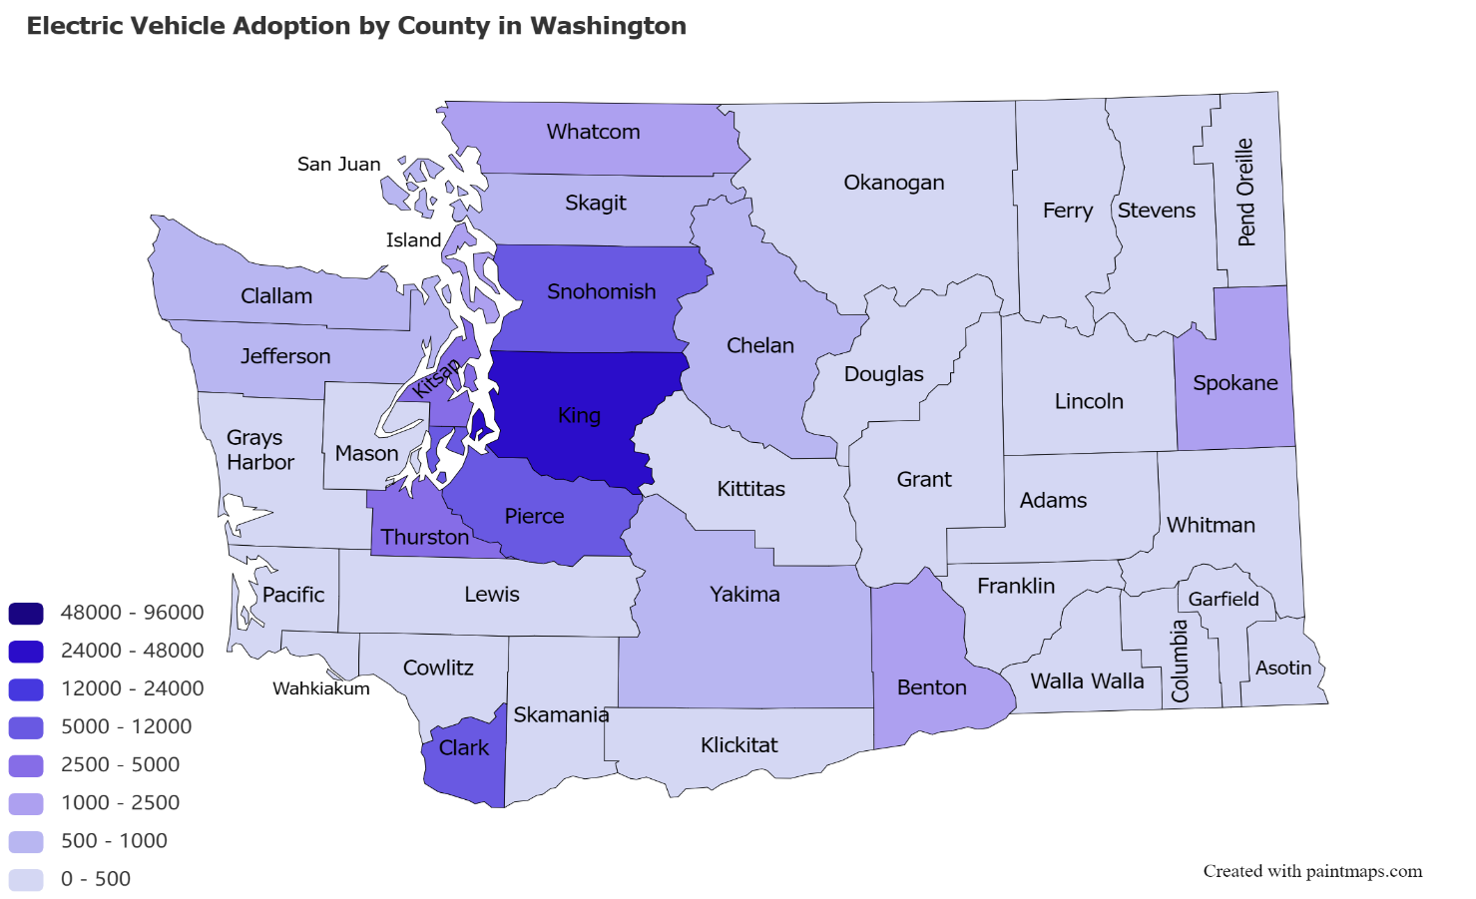
County-wise Electric Vehicle Population
This chart shows the increase in number of EVs in specific time frame in the form of Map Chart of Washington, county wise.
This Chart is derived from the data queried out from the main dataset and plays a very important role in the further analysis.
Counties like King, followed by Snohomish, Pierce, Clark, Thruston, Kitsap, Spokane and Whatcom are the key contributors of EV population increase (almost 89%)

Slide 14
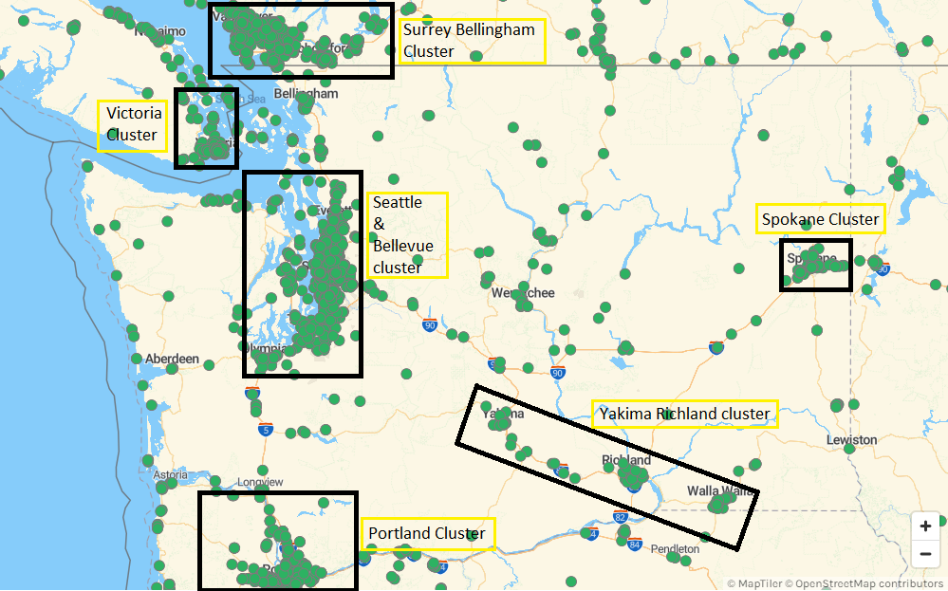
Charging Station Availability cluster Map Chart
A total Six EV charging Station Cluster can be seen the cluster map chart and they are named as
Three large size clusters
Surrey Bellingham Cluster
Seattle Bellevue Cluster
Portland Cluster
Three small size clusters
Victoria Cluster
Spokane Cluster
Yakima Richland Cluster
It is observed that all the key contributing counties are in vicinity of these charging station clusters.

Slide 15
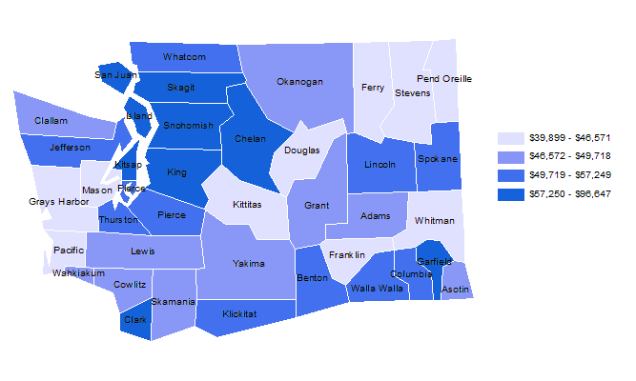
Per Capita Income Map Chart of Washington 2020
This map chart contains per capita income of each county of Washington collected from Washington State Financial Department’s Website.
Electric vehicles have high procurement cost at the initial stage.
It is observed that all key contributing counties are wealthy by their per capita income.
Some of the wealthy counties in descending order significant EV population are
King, Snohomish, Kitsap, Island
Clark, Pierce, Thurston, Spokane, Benton
Yakima

Slide 16
Average Price of EVs offered by Brands in The US Market 2022

Slide 17
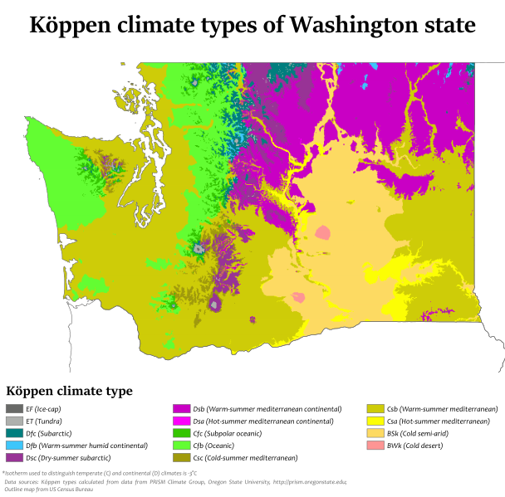
Köppen Climate Classification Map Chart of Washington
EV batteries have specific cell chemistries which are temperature sensitive.
General optimal temperature conditions for generic EV batteries are neither too hot nor too cold.
Washington has Köppen climate – Mainland climate is divided into several major categories, which are further subdivided into more specific climate types.
Counties with EV population has either Oceanic Cfb climate i.e neither too hot, nor too cold (green) or cold Mediterranean climate (golden)
Counties with less EV population have either Extreme continental (pink) or cold semi-arid (Cream) type of climate.

Slide 18
(BEVs, PHEVs) vs Cold Mediterranean Climate
In Cold Mediterranean regions of Washington
The number of PHEVs are almost 50% of the number of BEVs.
Due to less optimal climate rich customers chose PHEV over BEVs because they have the convenience of running on gasoline also.
Still the number of BEVs are more because PHEVS having both drivetrain options are generally expensive.

Slide 19
(BEVs, PHEVs) vs Oceanic Climate
In Oceanic regions of Washington
The number of PHEVs are less than 50% of the number of BEVs.
Due to optimal climate customers willing to invest on sustainable technologies, irrespective of their income chose BEVs for their good battery range and less expenses.

Slide 20
Observation
According to the analysis done.
Charging Station Availability is the most crucial factor followed by per capita income and climate type.
Most of the EV buyers have range anxiety issues.
People will buy EVs freely if they know that they have grid supply chargers capable of fast charging wherever they might be.
Must Emphasis on development of cell chemistries with better performance in extreme weathers to hasten EV adoption in such areas
3
Climate
2
1
Charging Station Network
Per Capita Income

Slide 21
Conclusion
The data analysis on EV vehicle population in Washington county-wise reveals several significant findings.
The EV population in each county is influenced by three key factors that play a crucial role in adoption rates.
The presence of charging infrastructure is a critical determinant. Counties with well-established charging stations exhibit higher EV adoption rates, as they provide convenience and reassurance to potential EV owners.
The per capita income of residents in each county significantly impacts EV adoption. Higher income regions tend to have a higher proportion of EVs due to increased affordability and willingness to invest in sustainable transportation options.
Lastly, the local climate also plays a role in EV adoption. Counties with milder climates, favorable for optimal battery performance, experience relatively higher EV penetration. Developmental works on new cell technologies for better power management at lower prices should be the primary list.
These three factors - charging infrastructure availability, per capita income, and climate conditions - interact to shape the EV landscape in Washington's counties.
Policymakers and stakeholders can utilize these insights to promote EV adoption by strategically focusing on improving charging infrastructure, providing financial incentives, developing inexpensive technologies to replace costlier parts, and raising awareness about the environmental benefits of electric vehicles.

Slide 22
Thank You

